Slide 1
Git Hub workshop
01.02.2023
Laura Güdemann, Ethan De Villiers

Slide 2
Topics of the workshop
Installing and configuring Git
Creating a GitHub account
Creating our first Repository
Uploading files to Repository
Connecting Repository and R Studio
Git Workflow
Terminology
Committing and Pushing
Version Control
Security

Slide 3


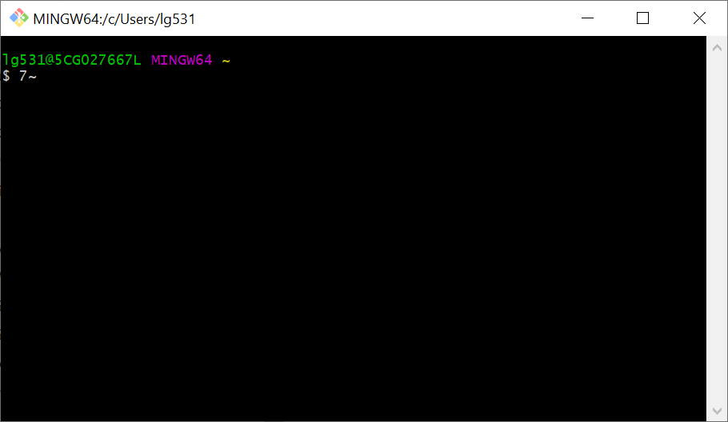


What is:
and more…
Notes:
Git: version control system, installed on your computer
Git Hub: Git repository hosting service, cloud based, to store your projects and collaborate
Git, Desktop, Git and Rstudio and Git Tortoise: Third party software that will help you to connect your local projects/ files on your computer to git Hub

Slide 4
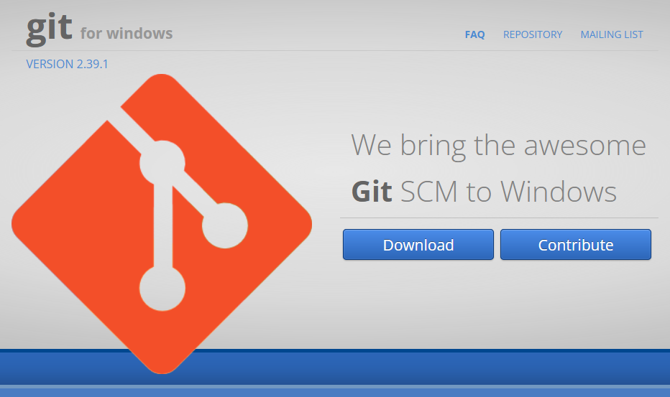
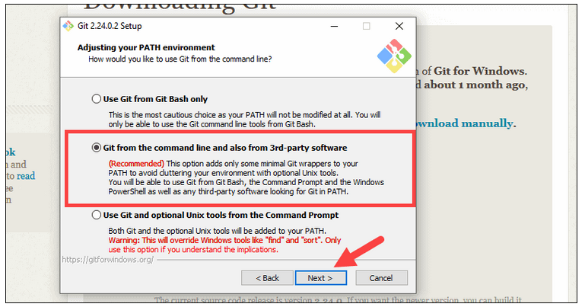
Task 1: install Git on your computer
Windows: https://gitforwindows.org/
MacOS: Terminal - "git --version"

Slide 5
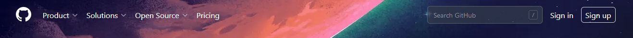
Task 2: Create a GitHub account
Go to: https://github.com/
use your work email address to create an account
Git hub will ask you to verify your email address

Slide 6
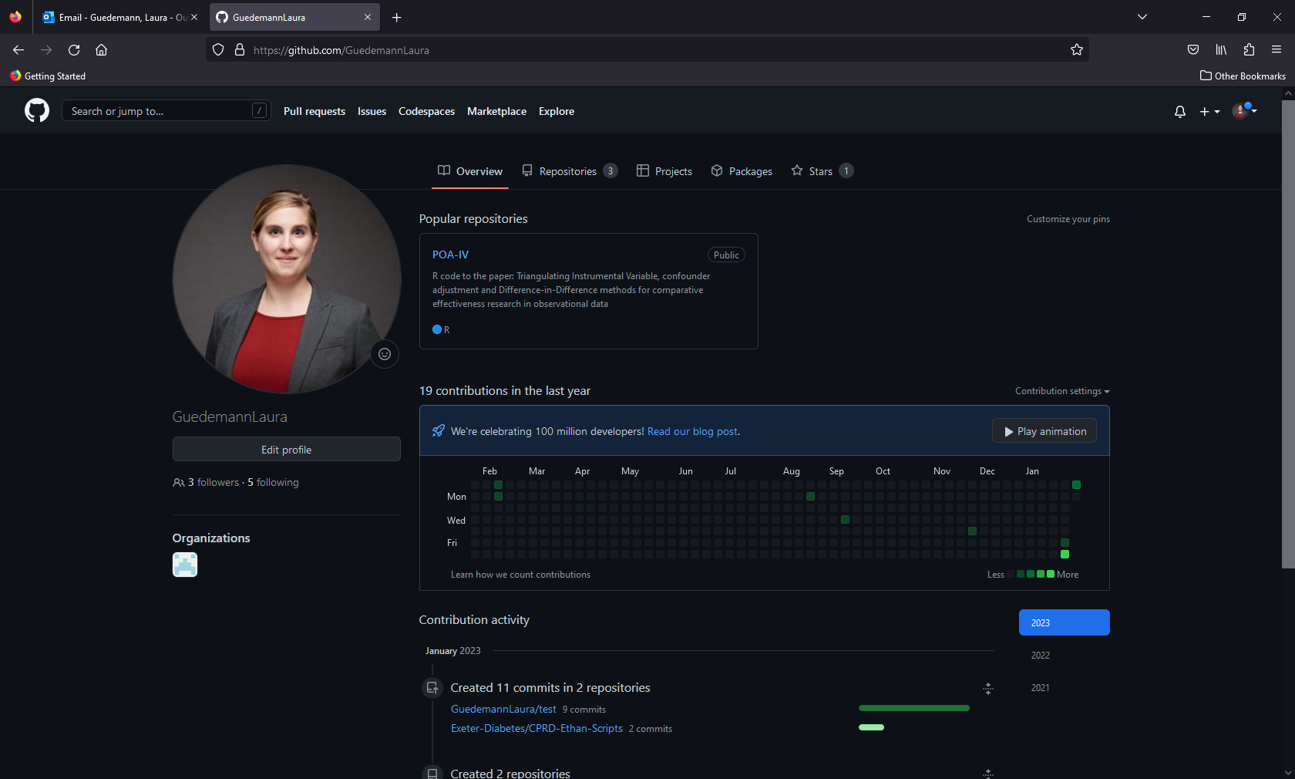
First look into the Git Hub account
Notes:
Here we can show them your personal Git hub account to explain them:
Taps in the profile section: Overview, Repositories, Projects, Packages, Star
Look into repositories:
Repositories are projects
You have the option of private and public repositories
These can be shared with collaborators or made public and linked to a paper for supplemental material in a publication

Slide 7
Task 3: Create your own first repository
On GitHub, create your own first repository
Click on “new”
Name Repository
Provide optional additional description of project
Choose whether repository is only viewable to you (private) or by anyone (public)
For this example, ensure the "README" file option is unticked

Slide 8
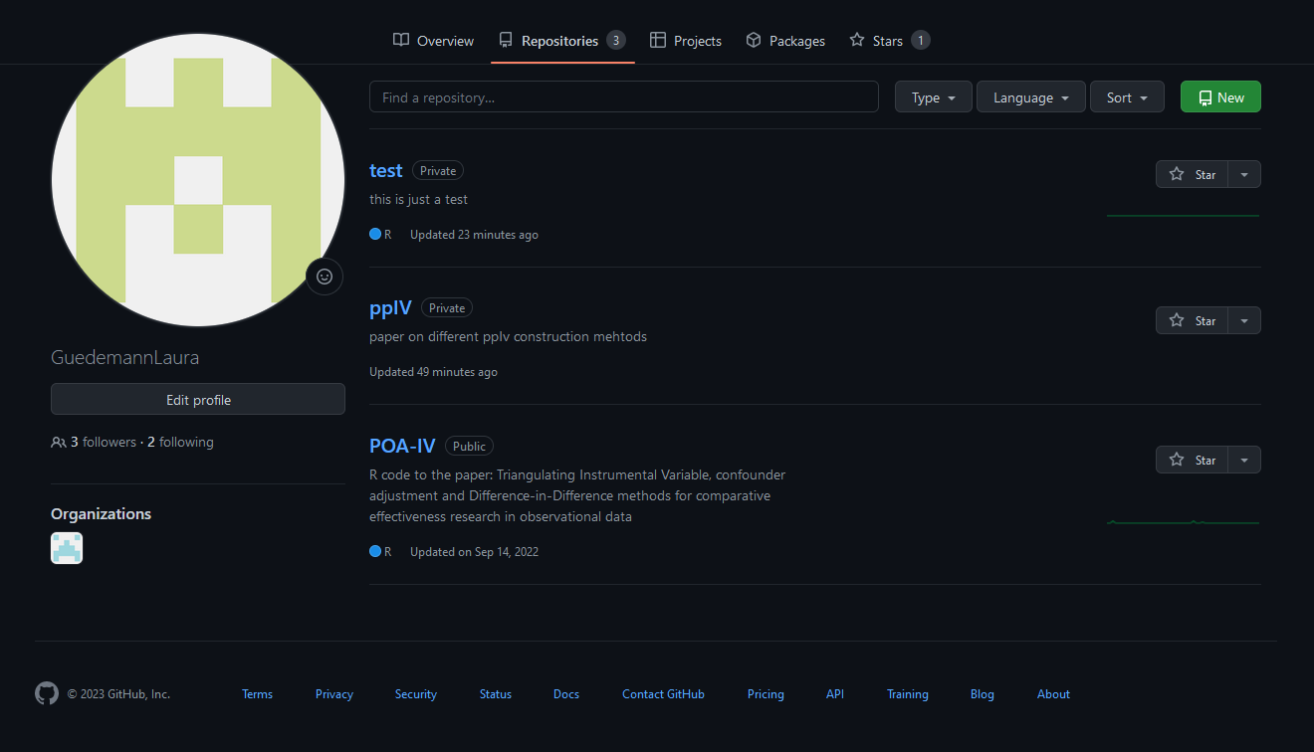

Slide 9
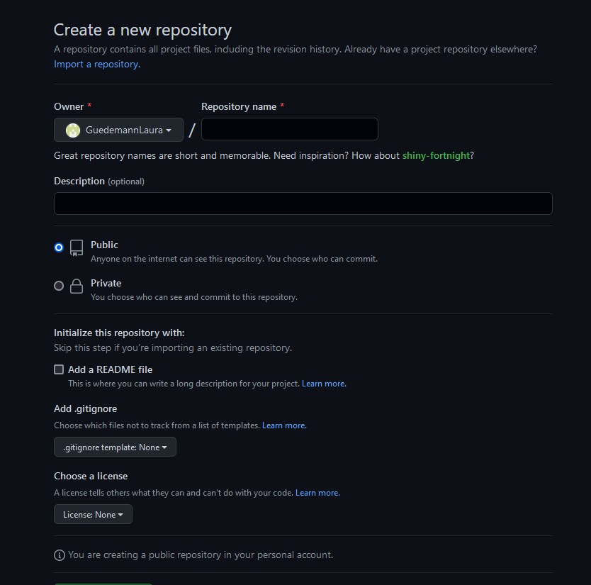

Slide 10
Task 4: Uploading files manually
You can manually upload files directly using GitHub at any point in time
Not just upon creating a new repository!
On the repository you have just created, click “upload files”
Click on “choose your files” and select the “README.md” file that was provided with this presentation
Write a brief summary of our changes:
“Uploaded README.md!”
Click “Commit changes”
Your file should now be visible on the repository!

Slide 11
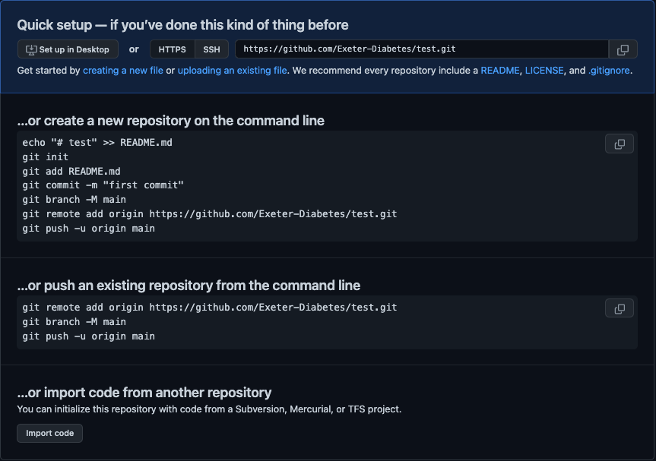

Slide 12
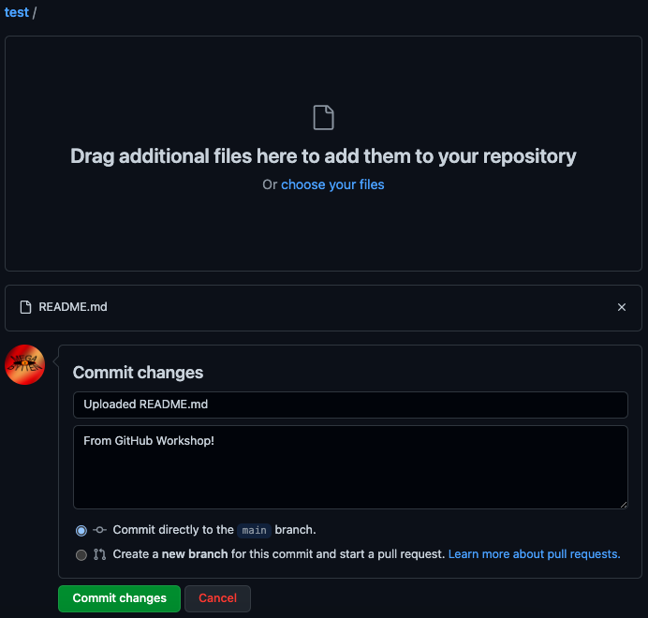
Upload Files
See uploaded files
Summarise Changes
Commit changes to repository

Slide 13
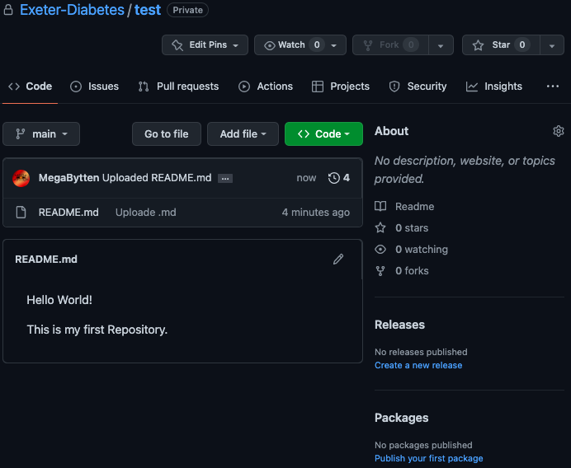

Slide 14
Task 5: Configuring Git
Git needs to verify your identity before you can make changes to GitHub
Security measure, otherwise anyone can change anything!
Open Command Prompt
Ensure Git is installed with command:
git --version
Use GitHub email and username to sign into Git with following commands
git config --global user.name "[username]" git config --global user.email "[email]"

Slide 15
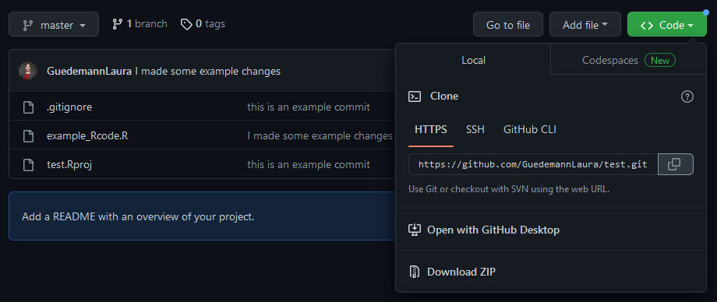
Task 6: Connect your repository to R Studio
We will now connect your new repository to R Studio and create a local clone of this project to work in on your computer
You will nee the https link of your project
Click this Button to open dropdown
Click this button to copy

Slide 16
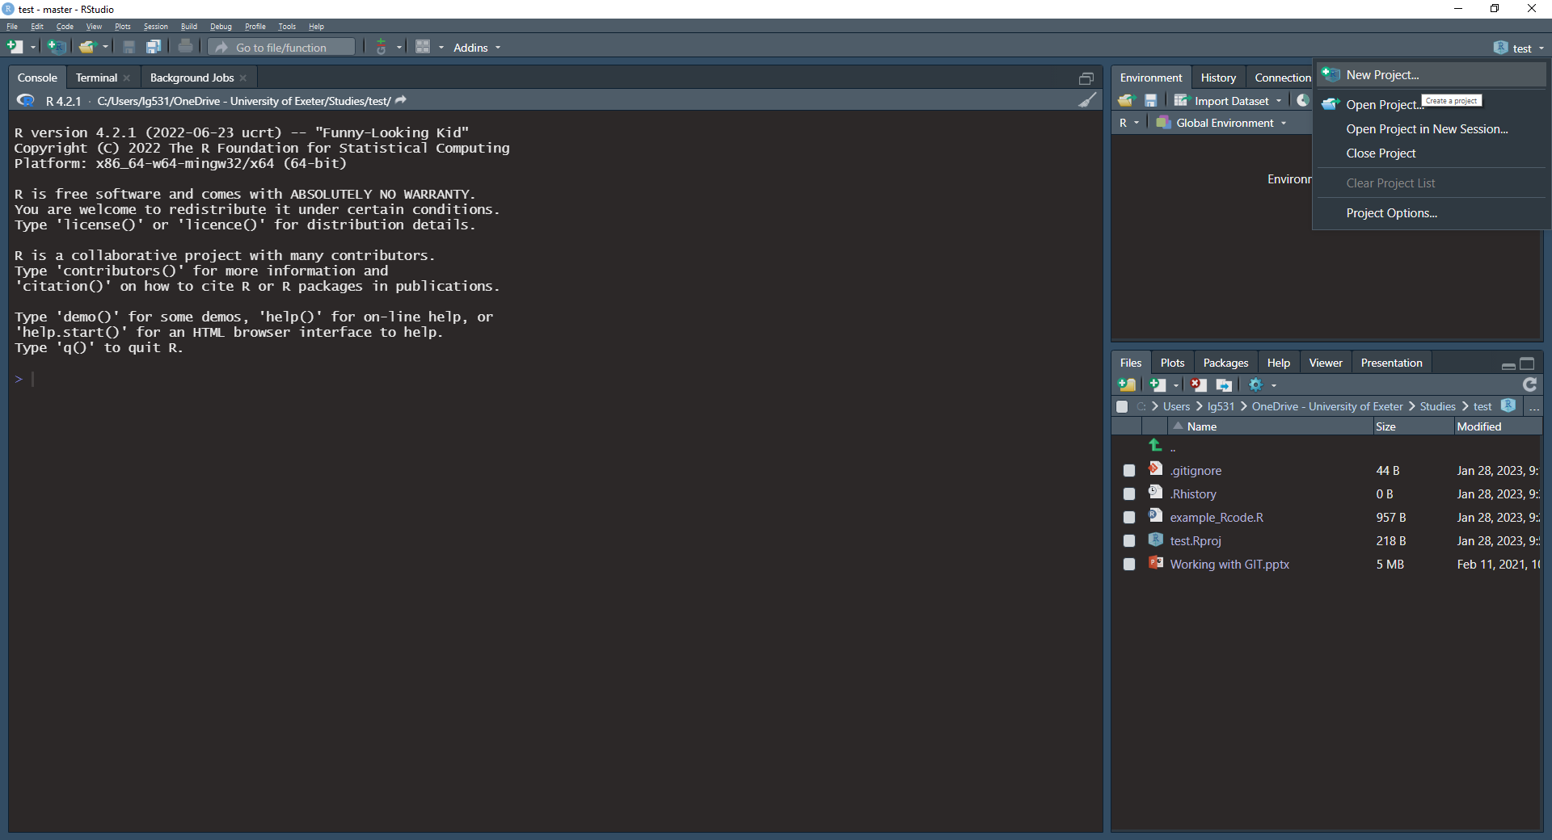
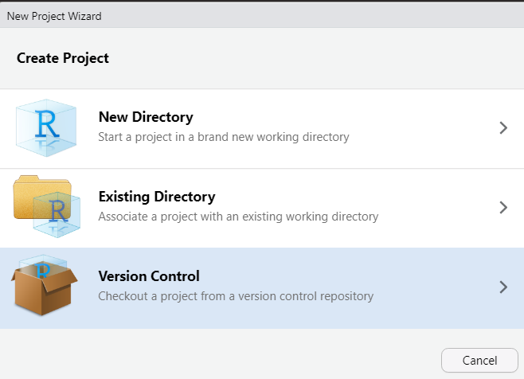
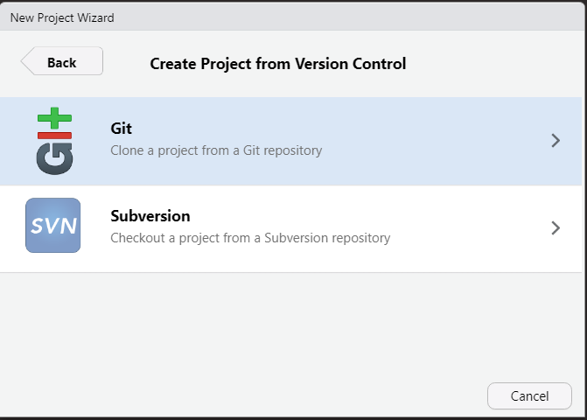
Create a project in R Studio
Create a new project in R Studio (right upper corner)
Click on “new directory”
And then click “clone a project from a Git repository”

Slide 17
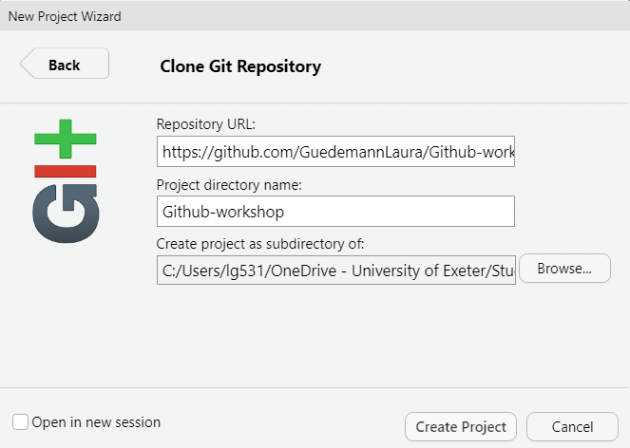
Create a project in R Studio
Enter the https link from the repository you want to clone
Cloning will create a new folder on you computer. We recommend to give it the same name as the Git repository
Decide where on your computer you want to clone the project
Click here to create the project

Slide 18
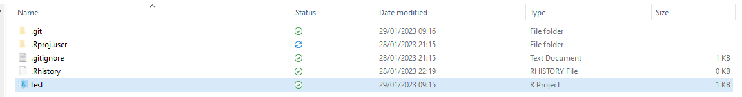
Create a project in R Studio
Go to the path on your computer where you cloned the repository to and take a look.
You are now ready to start developing!
Add files to project folder
Make changes to files within project folder
Synchronise changes between online repository and local folder
You will find an R Project file in the project folder on your computer. You have successfully created an R project that is connected to GitHub

Slide 19

Open Project in R Studio
You open the R Project in the upper right corner
^
Find your project in the correct path and open the R project file

Slide 20
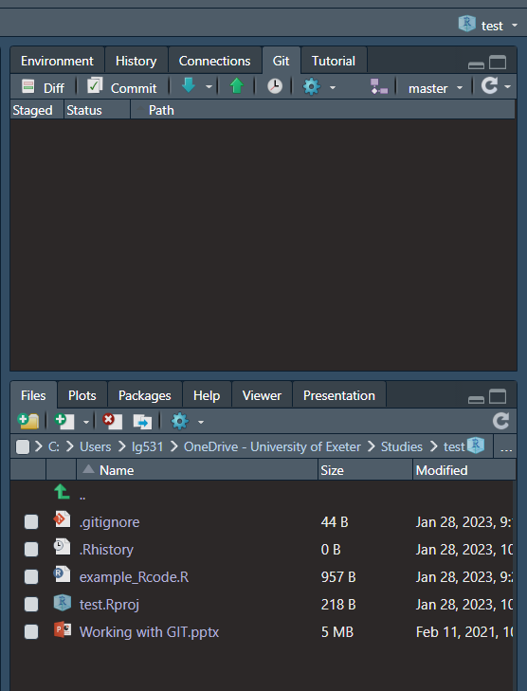
Open Project in R Studio
You can track the history of you project with any changes here
Here you can commit changes, pull and push
here you can see the files in your project

Slide 21
Basic overview of how Git works
All steps:
Create an account for a Git hosting tool (e.g. GitHub)
Create a "repository" (project folder) with the Git hosting tool (GitHub)
“Clone” (copy) the online-repository to your local machine
Software such as R Studio, Terminal, GitBash, TortoiseGit, or GitDesktop can help with this
Development:
If repository contains pre-existing files: make changes to files
If repository is empty: add local files to project folder
Commit changes to secure them
Push changes to the online-repository (eg.: master branch) on your Git hosting tool (GitHub)
Other members of the team can now pull your changes to their local repository.

Slide 22

Basic overview of how Git works
eg.: GitHub
Step 1:
Create an account for a Git hosting tool (e.g. GitHub)
Notes:
1. Get an account for an git hosting tool like github to get started

Slide 23
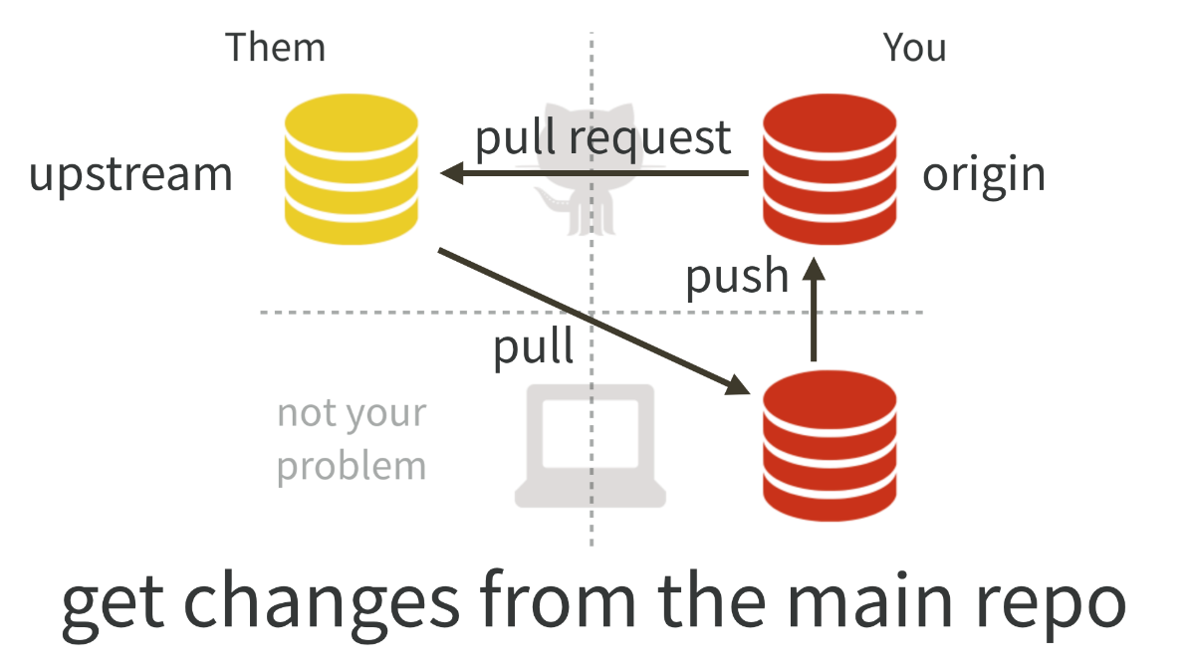
Basic overview of how Git works
eg.: GitHub
Step 2:
Create a "repository" (project folder) with the Git hosting tool (GitHub)
repository
Notes:
2. Create a "repository" (project) with the got hosting tool (GitHub)

Slide 24
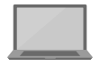

Basic overview of how Git works
eg.: GitHub
Step 3:
“Clone” (copy) the online-repository to your local machine
Clone: Isolated development environment
repository
eg.: with GitTortoise, Rstudio, Terminal
local repository
local repository
team member B
team member A
Notes:
1. Get an account for an git hosting tool like github to get started

Slide 25
Basic overview of how Git works
eg.: GitHub
Step 4:
Development:
Make changes to files
Add new files
repository
eg.: with GitTortoise, Rstudio, Terminal
local repository
local repository
team member B
team member A
Notes:
1. Get an account for an git hosting tool like github to get started

Slide 26
Basic overview of how Git works
eg.: GitHub
Step 5:
Commit changes to secure them.
repository
eg.: with GitTortoise, Rstudio, Terminal
commit
local repository
local repository
team member B
team member A
Notes:
Changes are not yet in the repository on GitHub but are secured.

Slide 27
Basic overview of how Git works
eg.: GitHub
Step 6:
Push changes to the repository (eg.: to the master branch) on your Git hosting tool (e.g.: GitHub)
repository
push
eg.: with GitTortoise, Rstudio, Terminal
commit
local repository
local repository
team member B
team member A
Notes:
Changes are now in the repository on GitHuB and can be pulled by the other team members

Slide 28
Basic overview of how Git works
eg.: GitHub
Step 7:
Other members of the team can now pull your changes to their local repository.
repository
pull
eg.: with GitTortoise, Rstudio, Terminal
local repository
local repository
team member B
team member A
Notes:
Pull changes and merge them with their local changes.

Slide 29
Basic terms
Feature: Used in software development (feature is a specific functional part of the software) for us, eg.: part of the code, specific analysis which is a part of the overall project, etc.
Version: An exact state of your code at a certain time. Versions are usually changed by adding new features or fixing old ones.
Commit: Saves your changes into your local repository and secures them. Essentially creating documented versions
Push: Sends your local commits (versions) to the remote repository (eg. in GitHub)
Branch: Copies of the project which can be developed independently of each other, but can be merged back into one main branch (copy). More explained in advanced workshop.
Main branch: Often synonymously referred to as “master branch”. This is the original and main branch (copy) of the project.
Forking: A process of branching when an individual/organization wants to take a project in a new direction and creates their own, unaffiliated branch (copy)
Notes:
Some Ressources:
https://www.atlassian.com/git/tutorials
https://www.youtube.com/watch?v=AMzIPsp5dGg
Copies of the master branch which can be worked on independently and can be merged back into the master branch after completion (more later)

Slide 30
Basic terms
Merge: A relatively automated process by GitHub to add external changes to your code. E.g., adding new lines of code from a different branch, or implementing a new commit where a collaborator deleted code responsible for a bug.
Merge conflict: An error which occurs when changes you are merging clash with your own changes. Eg. if two members alter the same line of code in one document in two different ways. Must be solved manually.
Pull request: Acts as a staging area before code commits are directly implemented into the target branch. Especially useful to review new changes and identify errors/issues before changes can break essential code.
Notes:
Some Ressources:
https://www.atlassian.com/git/tutorials
https://www.youtube.com/watch?v=AMzIPsp5dGg
Combining commits e.g., multiple branches to one branch or changes from multiple members of the teams into one document (there are different ways of merging, eg.: fast forward merging and three way merging)
Emerges for example if two team members alter the same line in one document in a different way. These have to be solved manually.
Let you tell others about changes you've pushed to a branch in a repository on GitHub. Once a pull request is opened, you can discuss and review the potential changes with collaborators and add follow-up commits before your changes are merged into the base branch.

Slide 31
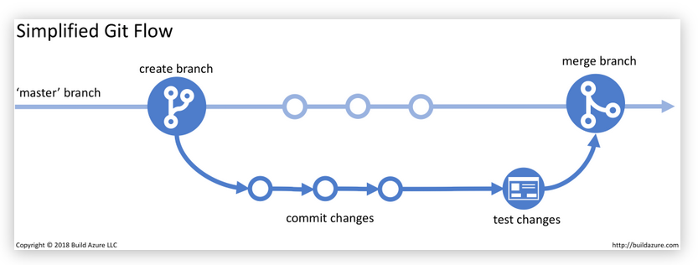
Notes:
Figure source: https://build5nines.com/introduction-to-git-version-control-workflow/

Slide 32
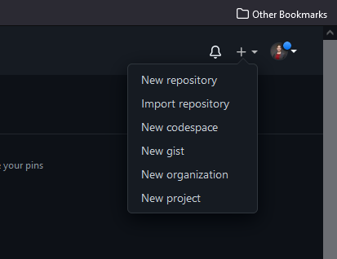
Basic terms
Projects: GitHub has a relatively new workspace called “Projects”, allowing you to manage Repositories by having any reported issues, todo-lists, pull-requests and ideas in one place.
Most of the time when “project” is used it refers to a folder or repository of code designed to accomplish one thing – not GitHub Projects.
Repository: A project-folder containing all of a project's code or files that is hosted online by a Git-hosting tool, not on your local device.
Organization: A GitHub-specific term, referring to both:
An online location where a team of individuals can collaborate
The team itself
Notes:
Some Ressources:
http://www.differencebetween.net/technology/difference-between-github-repository-and-project/

Slide 33
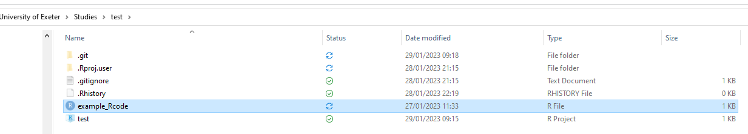
Task 7: Commit and push your first file to your repository
Locate the ”example_Rcode.R” script provided with this workshop
Copy/Paste or move the R file in the local folder of your R project
For now: don’t save the provided dataset in this project
I have copied the example R code in the R project folder

Slide 34
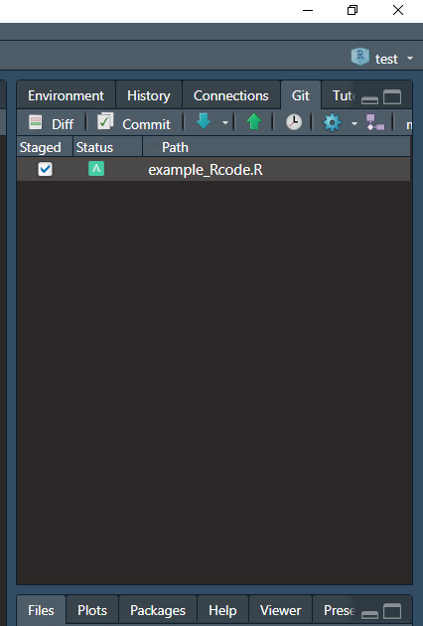
In the top-right panel of R Studio:
Click on “Git”
This panel will display all changed files within our project.
Tick the “Staged” for our ”example_Rcode.R” script.
This tells Git we want to commit this changed file.
Click on “commit” to start your first commit

Slide 35
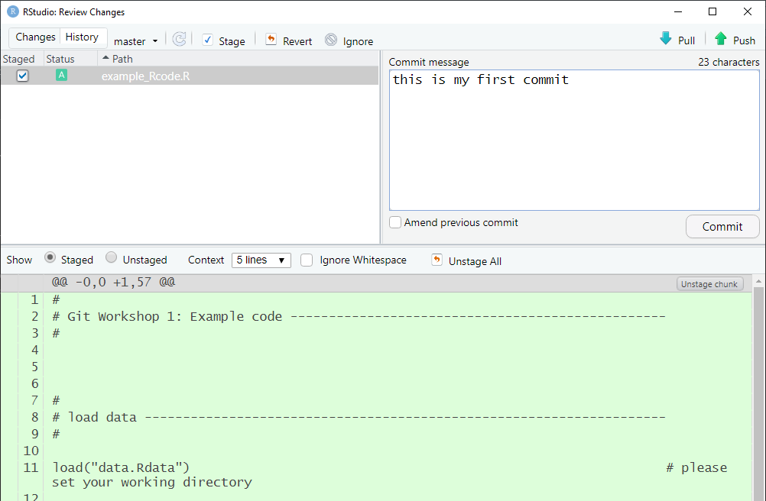
Enter a commit note, which will show up in your history on Git Hub. This way you can track why you made changes
Click commit

Slide 36
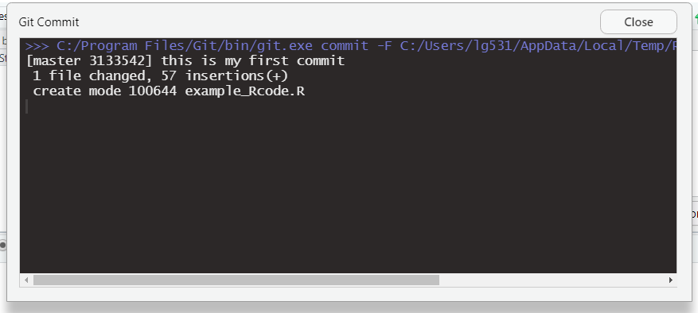
Congratulations, you have made your first commit!

Slide 37
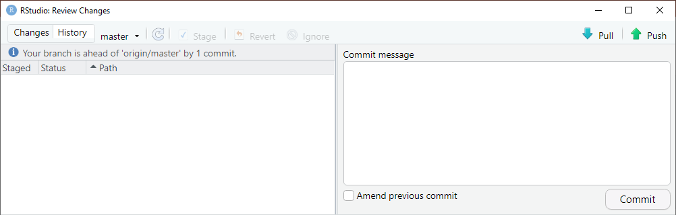
Pushing
We have now committed the changes in our local environment
Essentially creating our first new “Version”!
These changes are not synced with our online repository yet, so we must now PUSH
Click “Push” in the top right corner of the Commit page on R Studio.

Slide 38
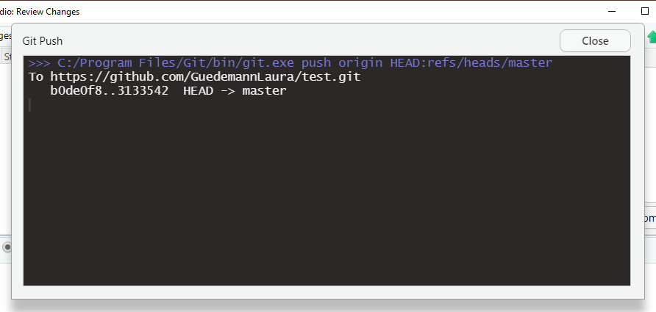
We pushed your R file into the “Master” branch

Slide 39
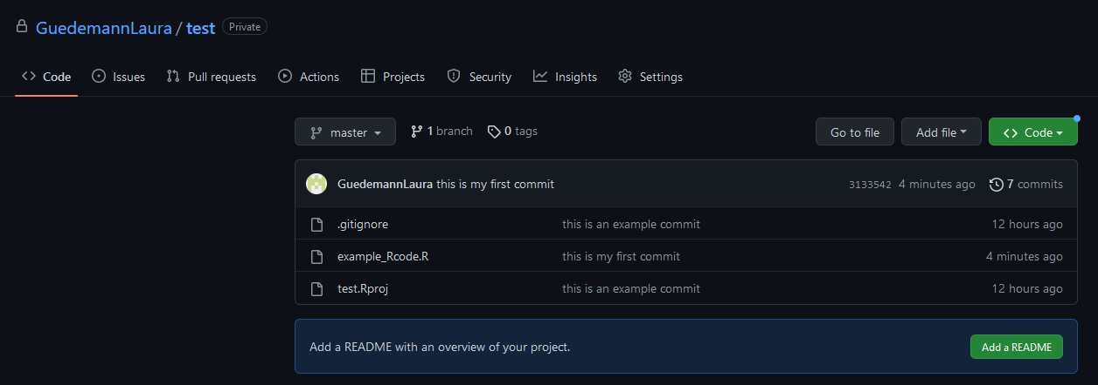
Task 8: Check your changes online on GitHub
Notes:
This is the moment when we can show them the change history and the changes in the document
Make some more changes in your R code by yourself, commit and push them and have a look at the change history on your Git Hub repository

Slide 40
Task 9: Make changes to script
Now that we know how to add and push new files, lets make some changes to our existing file
On R-Studio, double-click the “example_Rcode.R” file in the bottom right
Once the file has opened on the top left panel, make any change to the document
You can add a line, change some text, remove some text, or anything else.
Press Control + S to save these file changes - (Command + S on MacOS)
Alternatively navigate to File -> Save
Like the previous task, stage these changes in the top right “Git” panel and commit/ push them to GitHub.
Make sure to summarise your changes using the “Commit Message”!
Notes:
This is the moment when we can show them the change history and the changes in the document
Make some more changes in your R code by yourself, commit and push them and have a look at the change history on your Git Hub repository

Slide 41
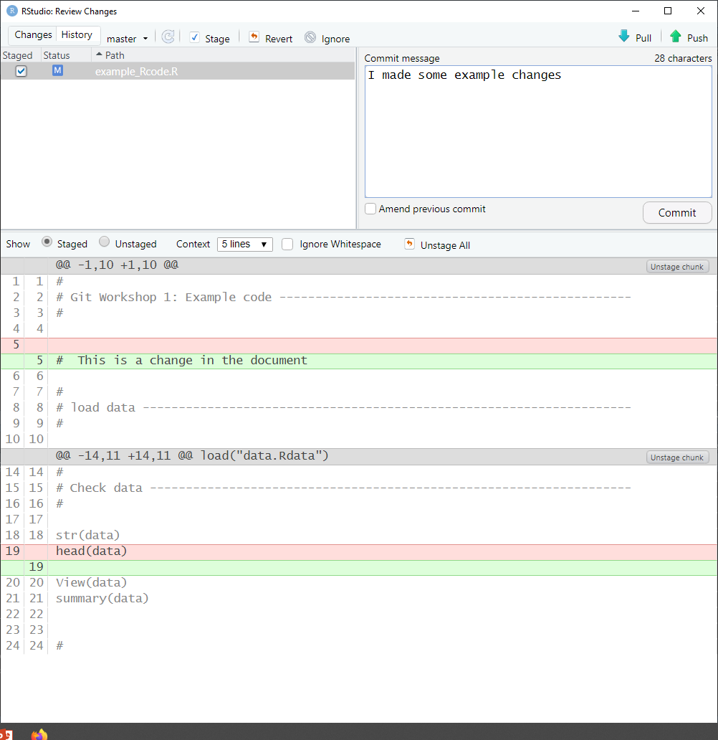
Changes in document

Slide 42

View Change History on GitHub
We’ve now changed files and synced these changes to GitHub
On GitHub, click the button to view all previous commits
Notes:
This is the moment when we can show them the change history and the changes in the document
Make some more changes in your R code by yourself, commit and push them and have a look at the change history on your Git Hub repository

Slide 43
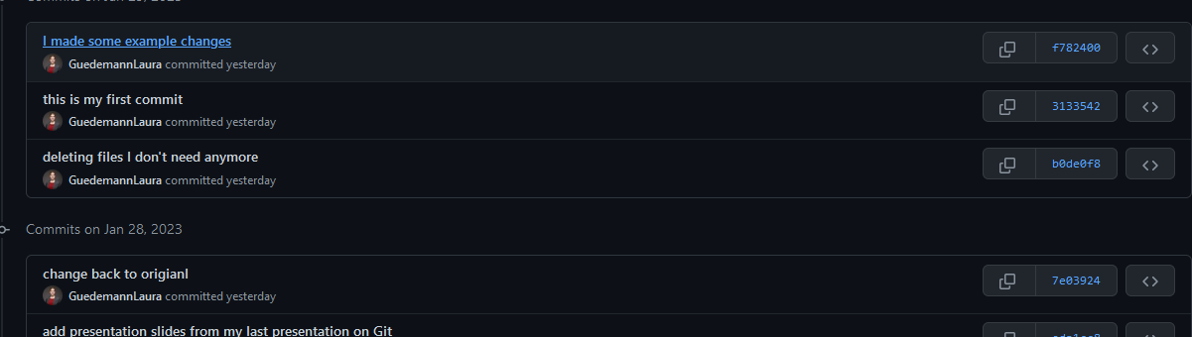
Commit History
This should open the Commit History – a list of all of your changes!
From here you can view which GitHub user made a commit, when, and what their commit message was
Click on a certain Commit for a more detailed insight

Slide 44
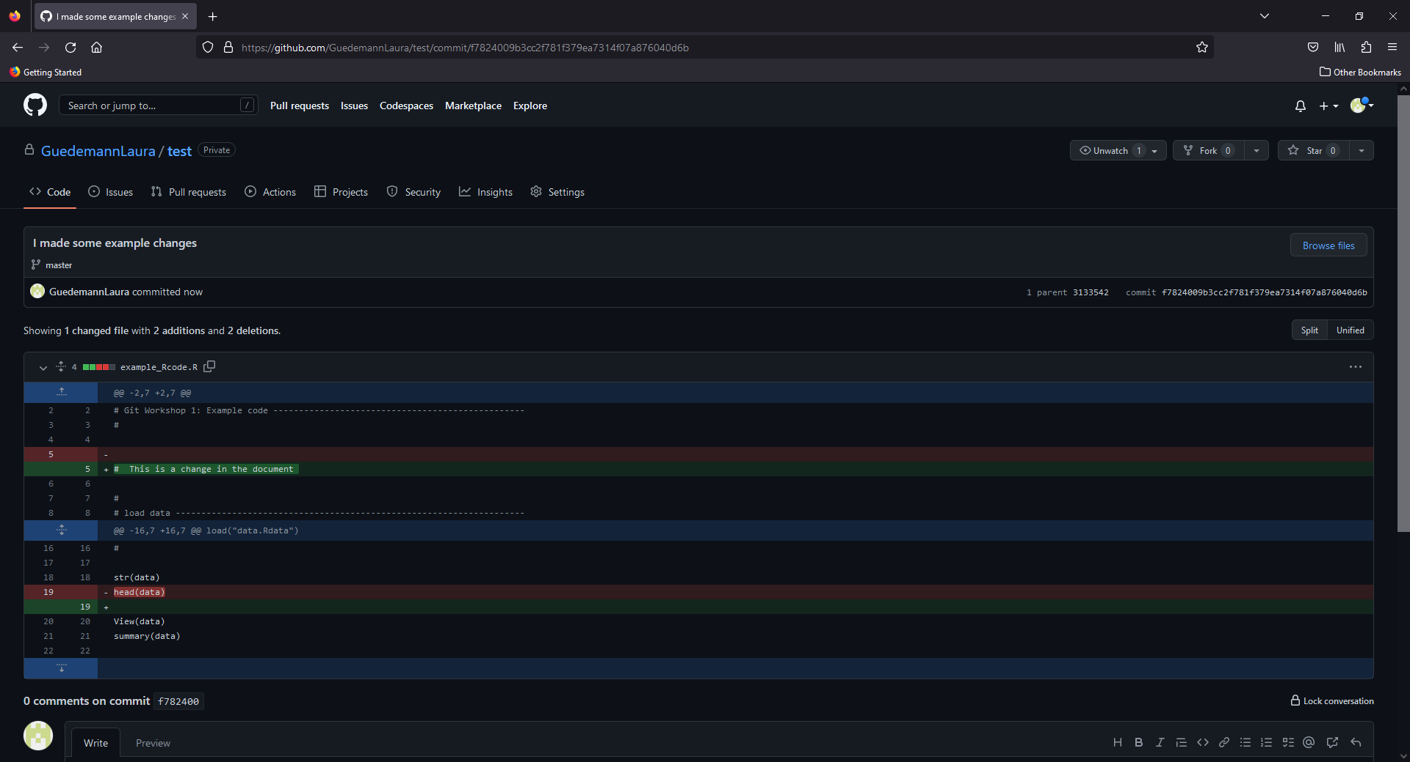
Changes in document

Slide 45
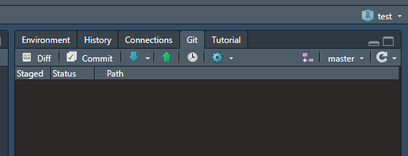
Task 10: Reinstate a previous version of a file (eg. to revert changes)
Tip for reverting commits:
When you revert multiple commits, it's best to revert in order from newest to oldest. If you revert commits in a different order, you may see merge conflicts.
Click on this clock to see the commit history

Slide 46
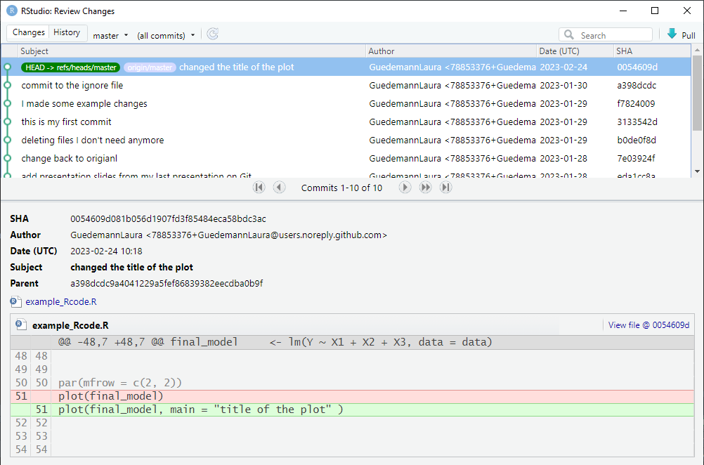
You can search for commits by file
Each commit has a number for identification

Slide 47
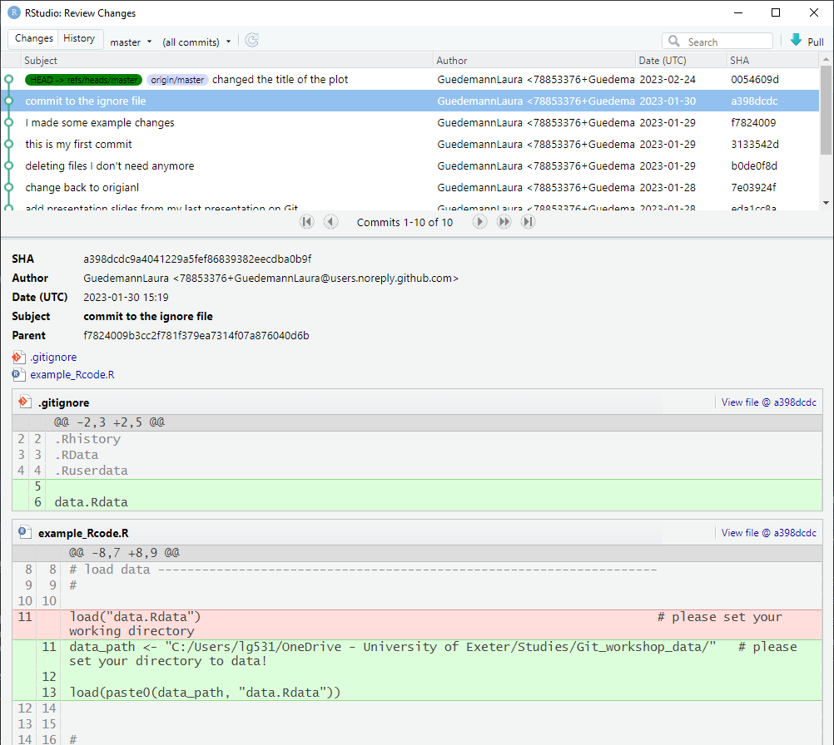
Click on the previous commit to see the previous state of the file before the last change
click on “View file @ ….”
To see the previous state of the file and to save it

Slide 48
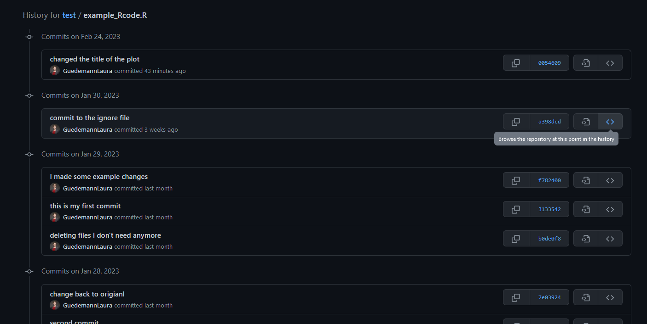
OR: you can have a look at the previous state of your file on GitHub

Slide 49

Security
When storing code, data or files online it is of utmost importance to stress security.
A rule that absolutely must be followed is to NEVER write log-in credentials (usernames, passwords, access-tokens, security tokens, pins) in code.
If you are committing and pushing these changes in your code, anyone online can access these
There are GitHub-scanning bots designed to scan GitHub repositories and obtain information that could be used to log in
Once a commit has been made to a repository you cannot delete that commit – you can only delete the entire repository
Even if it is a private repository – inaccessible to anyone on the internet except yourself – this data is still stored on a company’s server somewhere
Data leaks and security breaches do happen – nothing is ever CERTAINLY safe no matter how unlikely
When working with private datasets or other sensitive data be sure to consciously consider what you are pushing to GitHub
If in doubt, don’t!

Slide 50
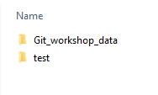
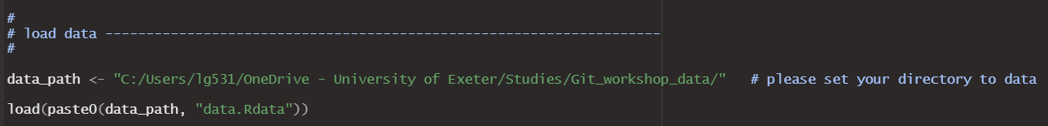
Task 11: Pushing a project with sensitive data
When working with sensitive, private data or similar security-concerning files; we need to handle with care.
A simple solution to avoid pushing sensitive data/files to GitHub is to store it in a completely independent place from your code
Store the data/files in another folder and define a path for it in your R code
This folder is not connected to Git Hub and includes all the sensitive data/files
this is the project connected to Git Hub
Change your R code and commit/ push these changes:

Slide 51
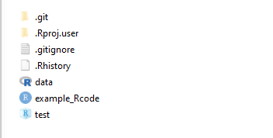
Task 11: Pushing a project with sensitive data
Another possible solution is to add the files which should never be pushed to Git Hub on to the .gitignore file in your R project folder

Slide 52
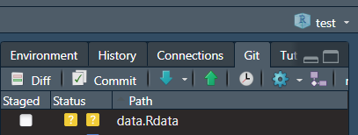

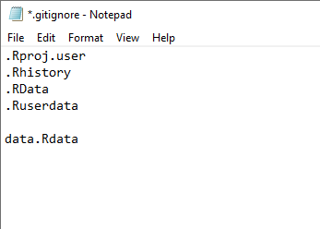
I copied a dataset into the folder of my R project, This change to the project will show up in R Studio.
This data is never to be pushed to Git Hub!
Add the file name of the data to the .gitignore file in your R project folder

Slide 53
Task 11: Pushing a project with sensitive data
Try it out yourself:
Add the data.Rdata to your .gitignore file
Make some changes in the R file and commit and push them to Git Hub
Check if data.Rdata has been pushed to Git Hub too!
You could even change something in the data.Rdata file and see if you can push it to Git Hub (you should not be able to!)

Slide 54
Override global push rules in a project
If you are the admin of a project on Git Hub, you can set global push rules and exclude data files by name or file type from being pushed onto Git hub
Please see more here: https://docs.gitlab.com/ee/user/project/repository/push_rules.html “override global push rules per project”
Notes:
We are not going to dive deeper into projects now

Slide 55
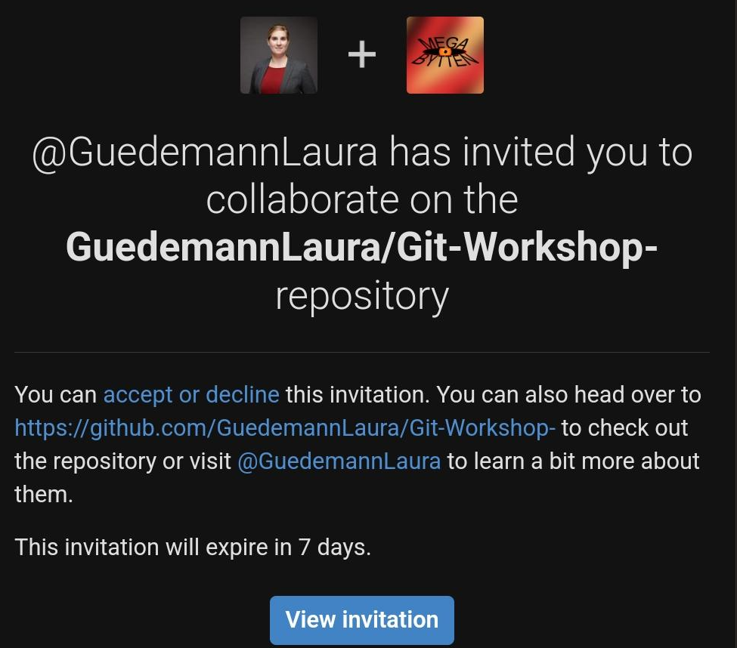
Task 12: Clone a repository for collaboration
You are invited to work on the repository “Git-Workshop”
Check your emails for the invitation
Clone this repository, as an R project (as we have done before)

Slide 56
Basic overview of how Git works
eg.: GitHub
Step 1:
Create an account for a Git hosting tool (e.g. GitHub)
Notes:
1. Get an account for an git hosting tool like github to get started

Slide 57
Basic overview of how Git works
eg.: GitHub
Step 2:
Create a "repository" (project folder) with the Git hosting tool (GitHub)
repository
Notes:
2. Create a "repository" (project) with the got hosting tool (GitHub)

Slide 58
Basic overview of how Git works
eg.: GitHub
Step 3:
“Clone” (copy) the online-repository to your local machine
Clone: Isolated development environment
repository
eg.: with GitTortoise, Rstudio, Terminal
local repository
local repository
team member B
team member A
Notes:
1. Get an account for an git hosting tool like github to get started

Slide 59
Basic overview of how Git works
eg.: GitHub
Step 4:
Development:
Make changes to files
Add new files
repository
eg.: with GitTortoise, Rstudio, Terminal
local repository
local repository
team member B
team member A
Notes:
1. Get an account for an git hosting tool like github to get started

Slide 60
Basic overview of how Git works
eg.: GitHub
Step 5:
Commit changes to secure them.
repository
eg.: with GitTortoise, Rstudio, Terminal
commit
local repository
local repository
team member B
team member A
Notes:
Changes are not yet in the repository on GitHub but are secured.

Slide 61
Basic overview of how Git works
eg.: GitHub
Step 6:
Push changes to the repository (eg.: to the master branch) on your Git hosting tool (e.g.: GitHub)
repository
push
eg.: with GitTortoise, Rstudio, Terminal
commit
local repository
local repository
team member B
team member A
Notes:
Changes are now in the repository on GitHuB and can be pulled by the other team members

Slide 62
Basic overview of how Git works
eg.: GitHub
Step 7:
Other members of the team can now pull your changes to their local repository.
repository
pull
eg.: with GitTortoise, Rstudio, Terminal
local repository
local repository
team member B
team member A
Notes:
Pull changes and merge them with their local changes.

Slide 63
Task 13: Pull changes from the repository “Git workshop”
Next: Laura & Ethan are going to make some changes to the repository “Git workshop”
Let’s have a look if you can see the changes in your Rstudio project on your laptop!
Why can you not see any changes yet?

Slide 64
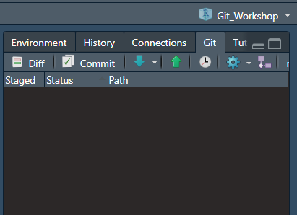
Task 13: Pull changes from the repository “Git workshop”
In Order to pull the changes in your local version of this project you need to pull them
Make sure you are in the correct project
Click blue arrow to pull changes

Slide 65
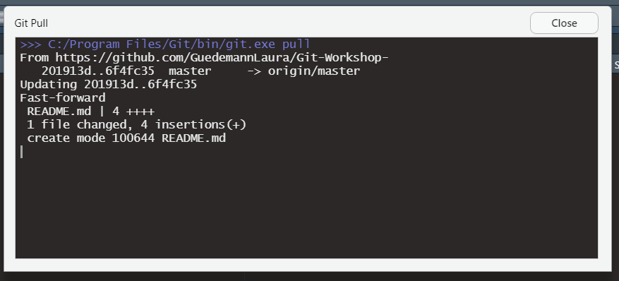
The pull report an look something like this.
You should be able to see the changes on your local version after the pull

Slide 66
Task 14: Let’s try to create a merge conflict
Merge conflict can arise when collaborators create changes in the same document that are conflicting:
Eg.: changes in the same line of code
Before you start working on a file, always make sure that you pull all previous changes in order to work on the most up to date version!

Slide 67
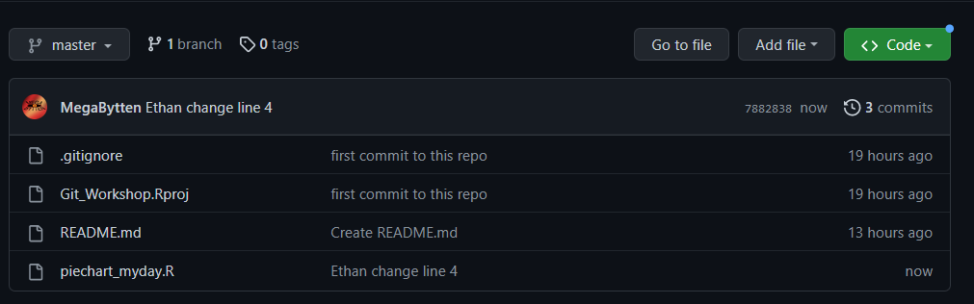
A collaborator has made a change on line 4 in one of the Rcodes you are working on
What happens if you work on line 4 at the same time without pulling your collaborators changes beforehand?

Slide 68
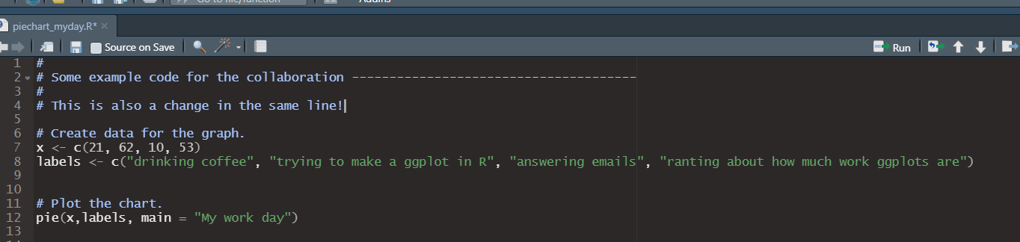
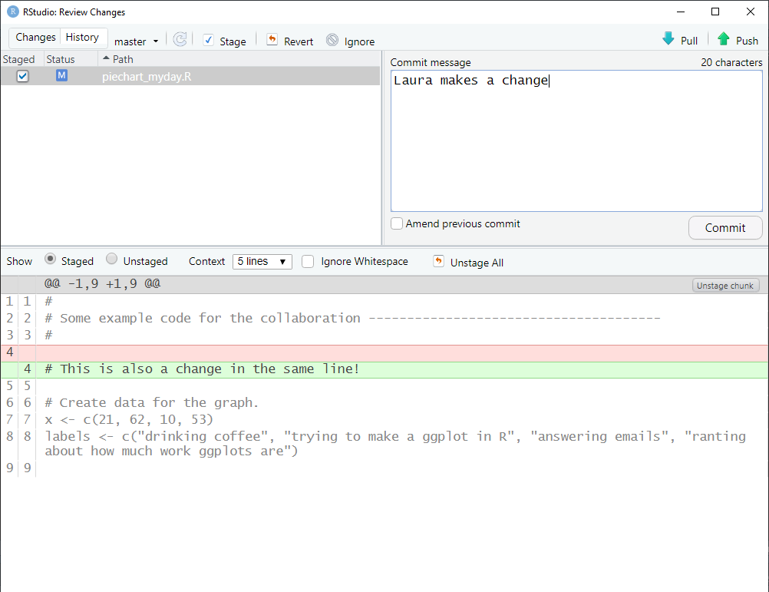
I am trying to make a change in the same line
Can I commit and push this change to Git Hub?

Slide 69
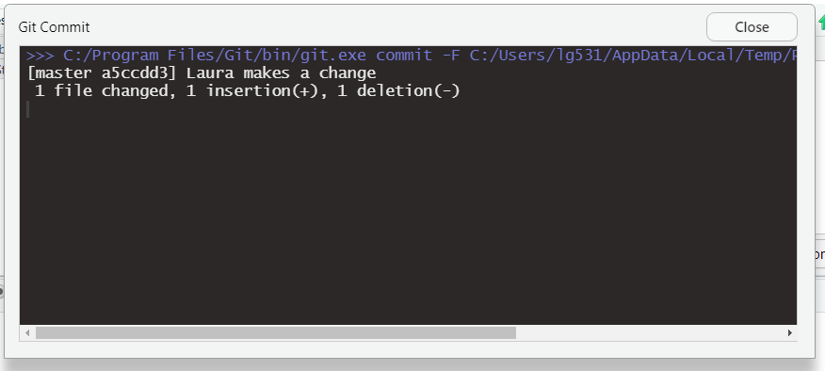
Can I commit and push this change to Git Hub?
→ yes, I am able to commit my changes locally!

Slide 70
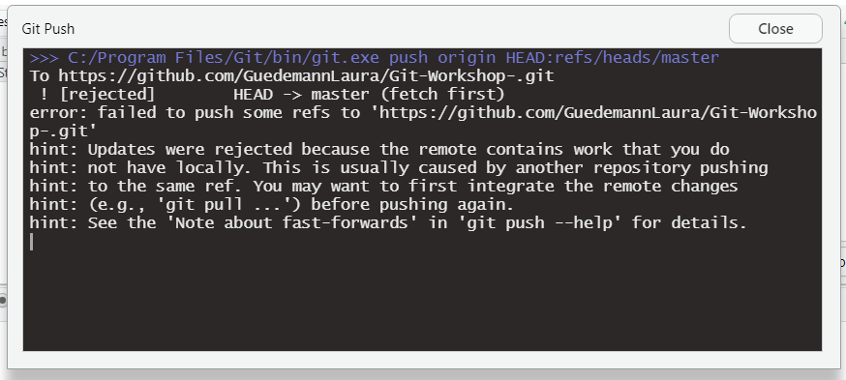
Can I commit and push this change to Git Hub?
yes, I am able to commit my changes locally!
No, I am not able to push my changes on the Git Hub repo! → merge conflict!

Slide 71
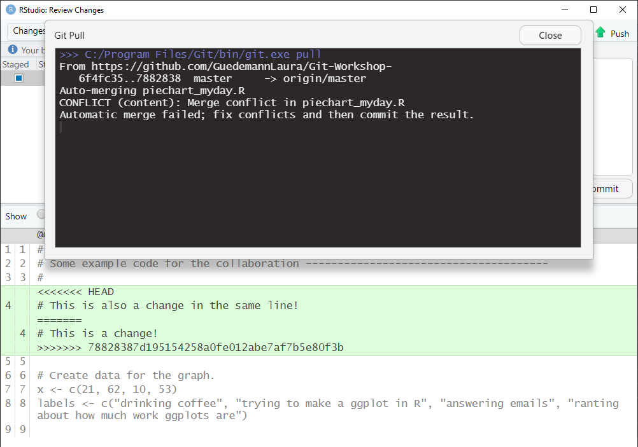
Git makes an effort to tell me what is wrong
I should have pulled the changes made by my collaborator beforehand!
Now I need to solve the merge conflict manually
In this report I can see my changes and also the changes of my collaborator which are conflicting
Notes:
I pulled

Slide 72
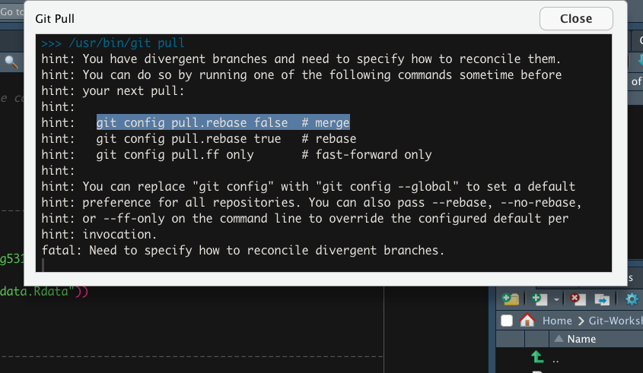

git config pull.rebase false

Slide 73

Once I pulled the version from Git Hub I can see the two conflicting changes in my R code.
I will have to decide manually which one should be kept
Local Version
Repo Version
Notes:
Both changes ae in here→ we have to manually resolve this and commit/pull it again to the repo on git hub

Slide 74

Branching
So far we have only worked in the main branch of your repository
If you are collaborating, it makes sense to create a branch for every work package
Idea:
changes to the project are not made in the main branch
Main branch always contains the latest approved version of the project that runs without errors
Changes or adding of new features is done in branches
Ones a change/ new feature to the code has been approved by the project lead, the branch with the change/ new feature can be merged to the main branch

Slide 75



Task 15: Create your own branch in the repository “Git-Workshop” using RStudio
Create your own branch from the master branch
Use your name “branch_yourname” in order to make it identifiable
Branch created from master branch (origin)

Slide 76


your branch should be visible on Github shortly after you have created it in RStudio
You can see all the branches in the repository
All branches are an exact copy of the master branch

Slide 77
Master branch
branch_LauraG: LauraG makes her changes in this branch
Merge individual branches with main branch after changes have been approved
branch_EthandV: Ethan will make his changes here
branch_yourname: you will make your changes here

Slide 78


Task 16: Make changes in your branch and commit/ push them
Please make sure that you are working in the correct branch
There is a file called “piechart_myday_yourname”
Change the file name to include your name
Make some changes to this R code

Slide 79

GitHub tells you that a certain branch is different from the master branch

Slide 80

Task17: Let’s merge your branch to the master
Branches are merged once the changes/ new feature have been tested and approved
If you have changes the R file name to include your name, we should not get any merging issues.
The master branch should have all individual R files with our names in it
Under “View all branches” create a pull request

Slide 81


Slide 82


Slide 83


Slide 84


Slide 85

Master file will now have the personal file from branch_LauraG

Slide 86

Branches can also be deleted here

